Slide 1
Node JS
Banuprakash
banuprakashc@yahoo.co.in
banu@lucidatechnologies.com

Slide 2
Node JS
Node.js is a platform built on V8 engine runtime for easily building fast, scalable network applications.
Node.js uses an event-driven, non-blocking I/O model that makes it lightweight and efficient, perfect for data-intensive real-time applications that run across distributed devices.
Created by Ray Daul in 2009

Slide 3
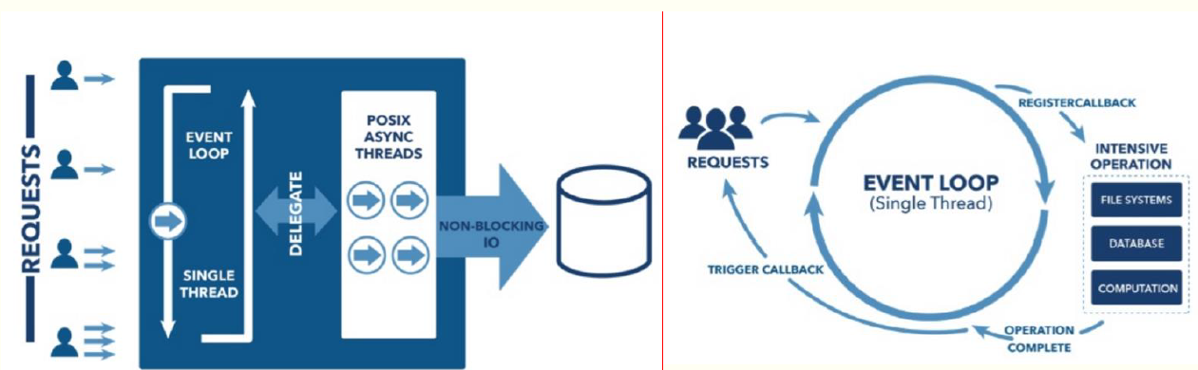
Event loop

Slide 4
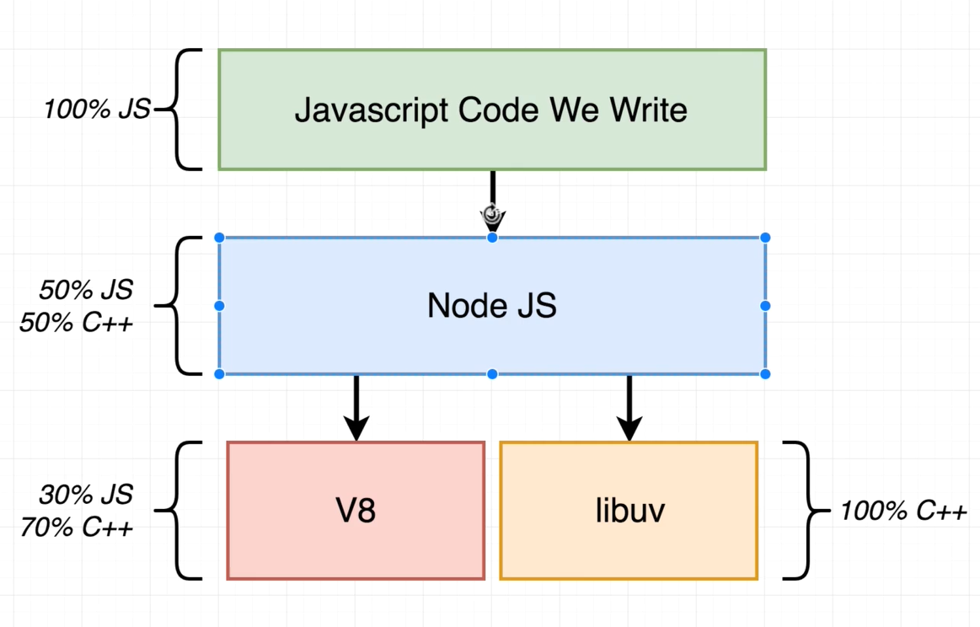
Internals of Node JS
Node JS internally has a collection of dependencies that it uses to execute JS code
Two of the most important dependencies are
V8 – open source JavaScript engine created by google
libuv – open source C++ project, which gives access to underlying filesystem, networking, threads and concurrency

Slide 5
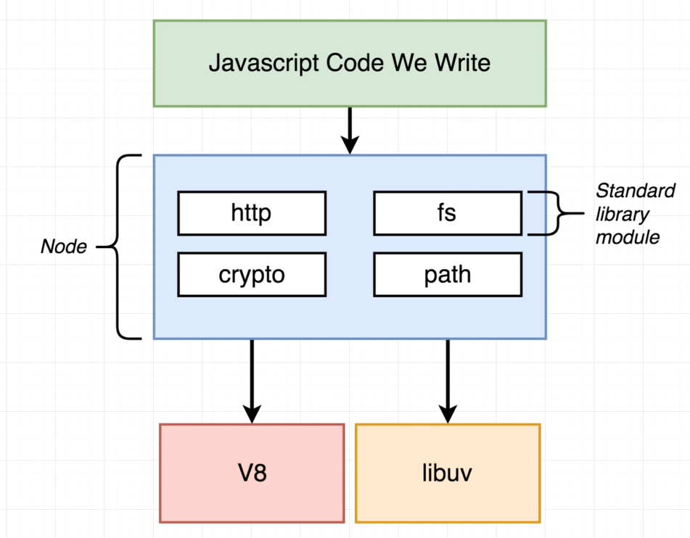
Internals of Node JS
Node JS provides a wrappers with very consistent APIs

Slide 6
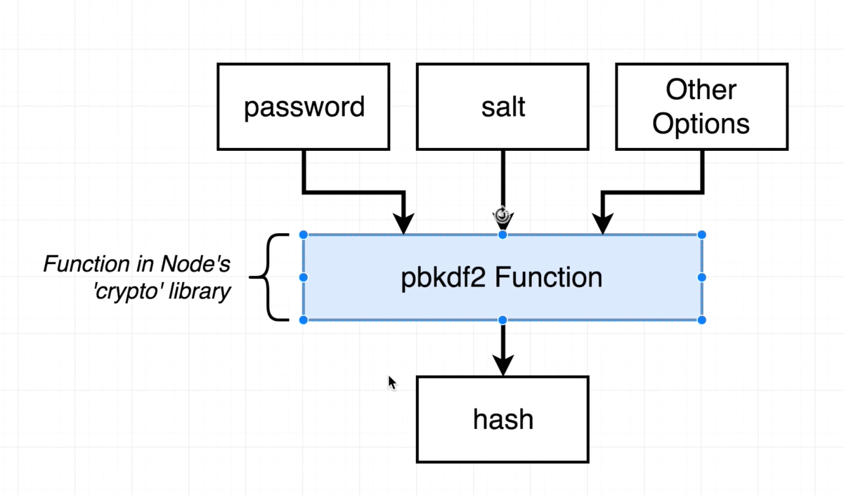
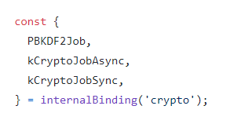
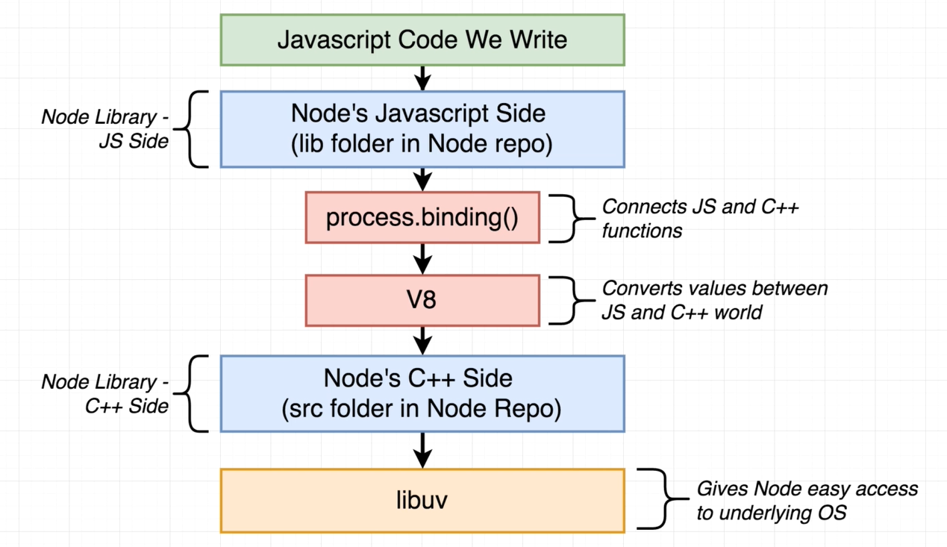
Internals of Node JS
See how V8 and libuv are used to implement Node JS function
https://github.com/nodejs/node/blob/master/lib/internal/crypto/pbkdf2.js
https://github.com/nodejs/node/blob/master/src/node_crypto.cc
internalBinding()

Slide 7
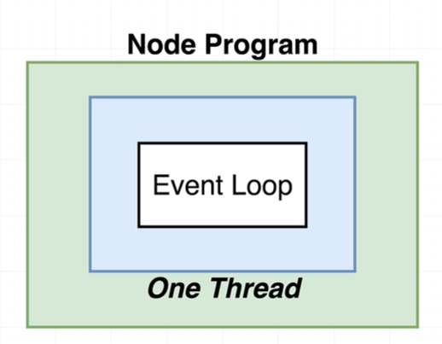
Node Event Loop
Whenever Node process starts it creates a thread, inside that thread is a event loop.
Think of event loop as a control structure where one thread should be doing at any given point of time
Event loop is the core of how Node program runs.

Slide 8
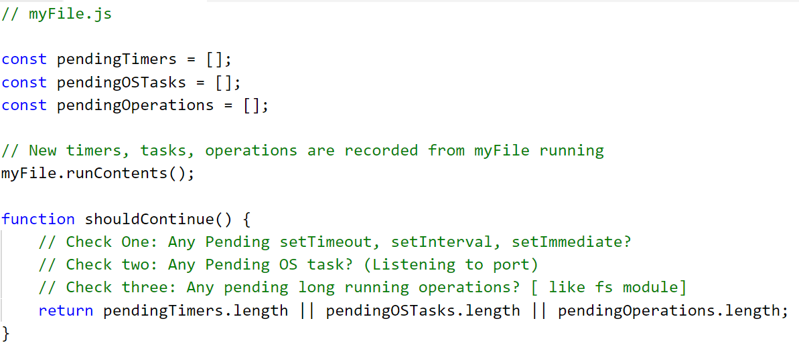
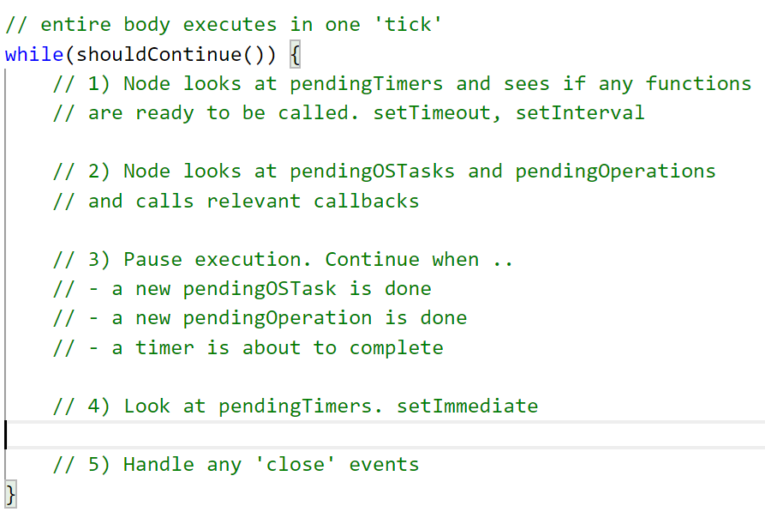
Event Loop pseudo code

Slide 9
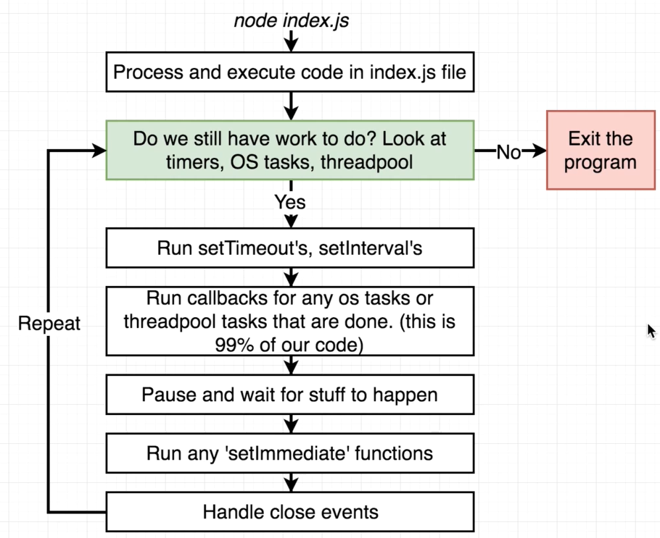
Event loop Review
Each phase has a FIFO queue of callbacks to execute.
When the event loop enters a given phase, it will perform any operations specific to that phase, then execute callbacks in that phase's queue until the queue has been exhausted or the maximum number of callbacks has executed.
When the queue has been exhausted or the callback limit is reached, the event loop will move to the next phase, and so on.

Slide 10
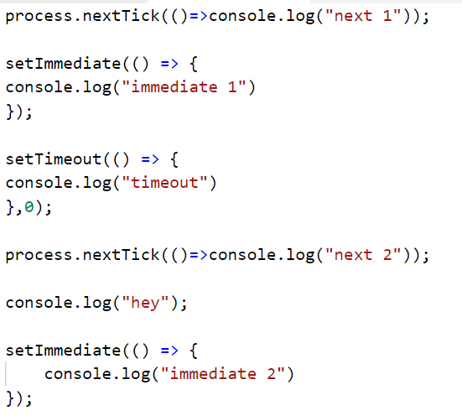
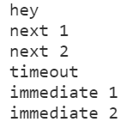
process.nextTick() vs setImmediate
process.nextTick() fires immediately on the same phase
setImmediate() fires on the following iteration or 'tick' of the event loop

Slide 11
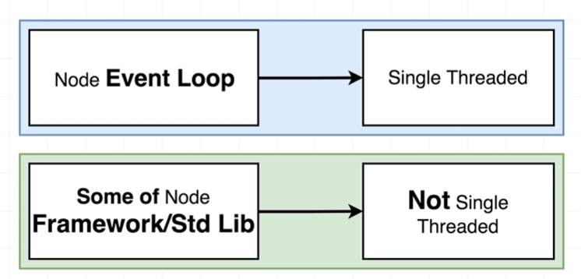
Threads
Threads in Node JS

Slide 12
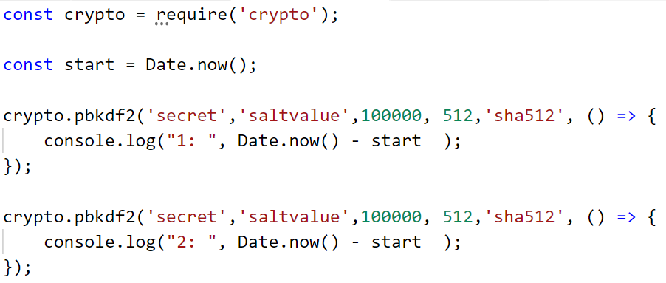


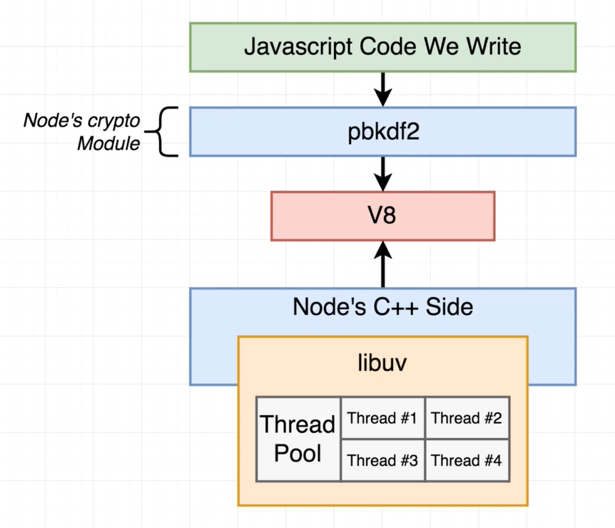
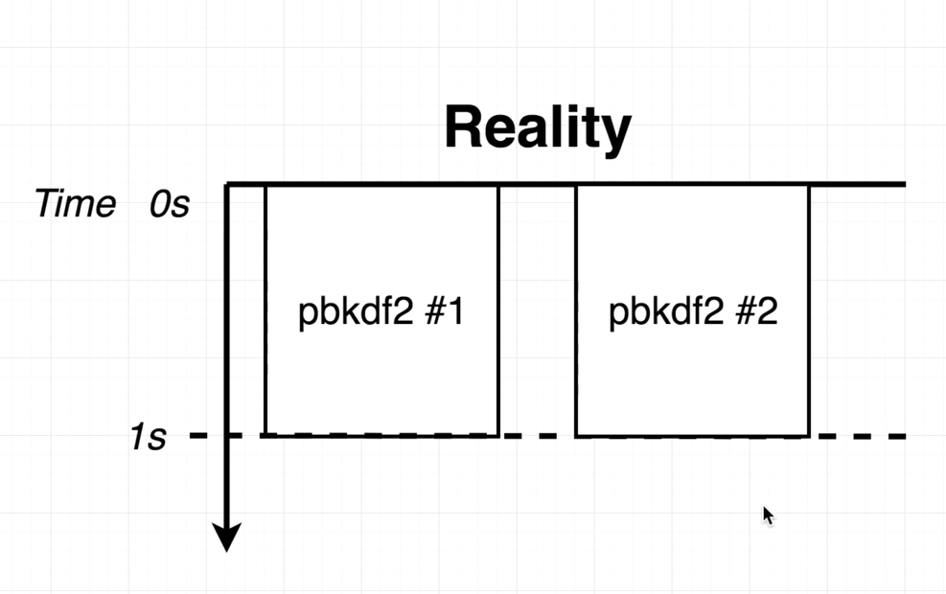
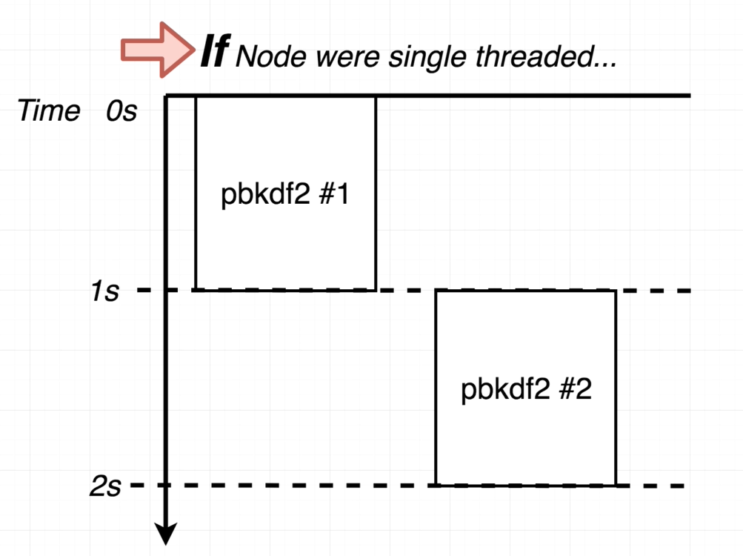
Threads

Slide 13
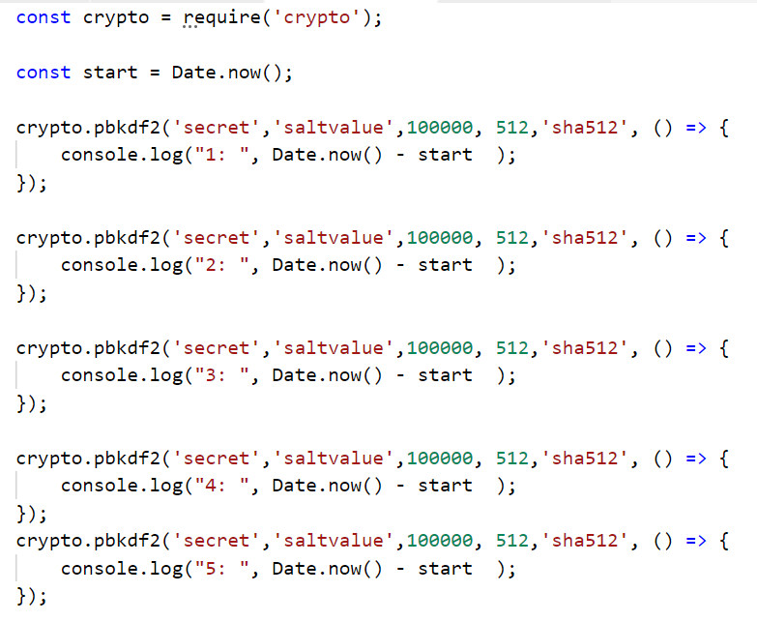
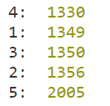
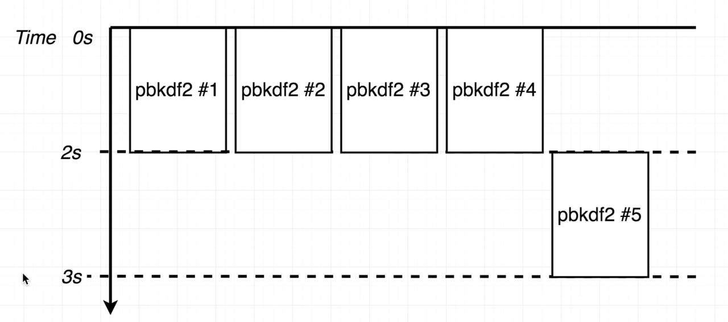
Thread Pool

Slide 14
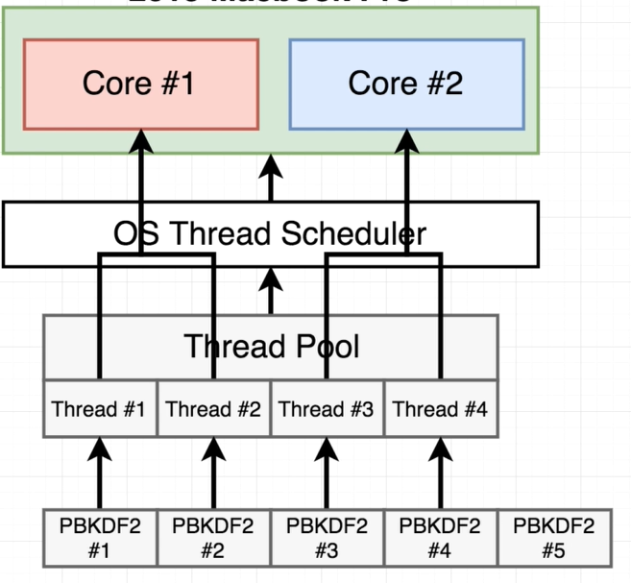
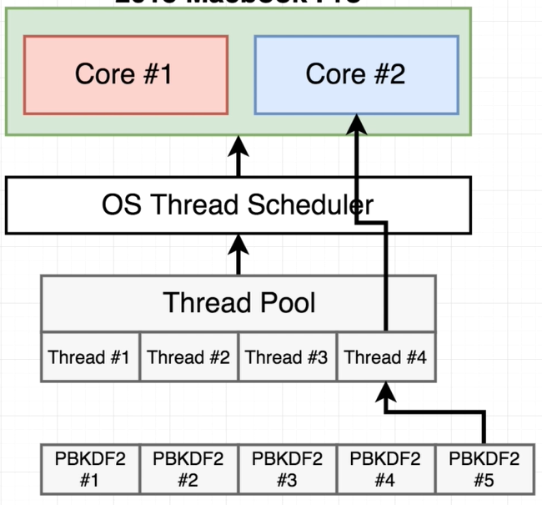
Thread Pool
Each core has more threads to handle, hence more time compared to
previous execution with only 2 threads

Slide 15
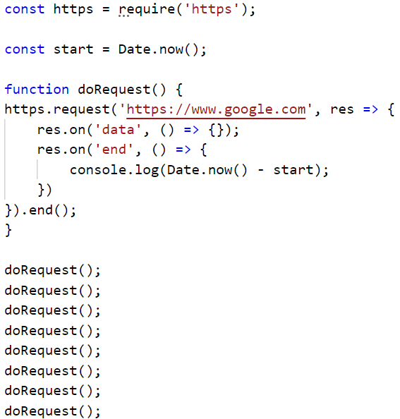
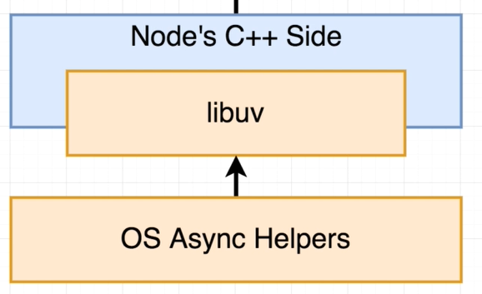

Async operations
Some function calls in NodeJS are delegated directly to the underlying OS outside of the thread pool
Almost everything around networking uses OS’s async features.
Tasks using the underlying OS are reflected in our ‘pendingOSTasks’ array

Slide 16
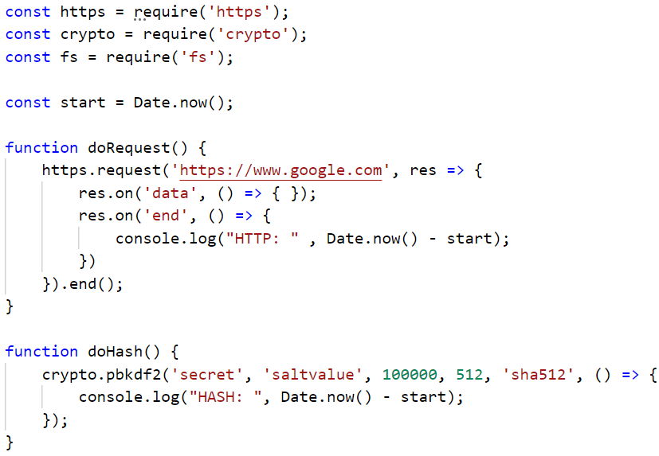
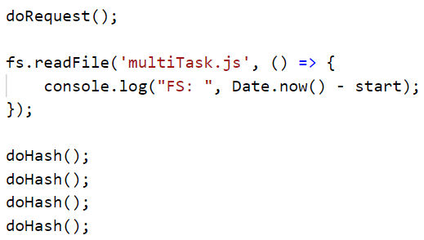
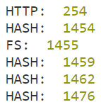
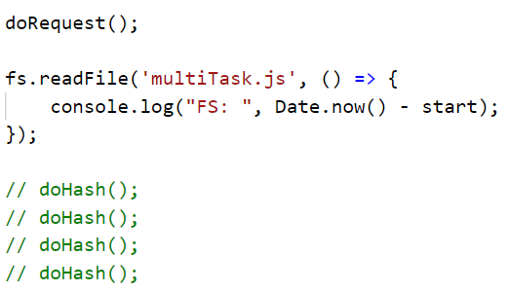

Multi Tasking

Slide 17
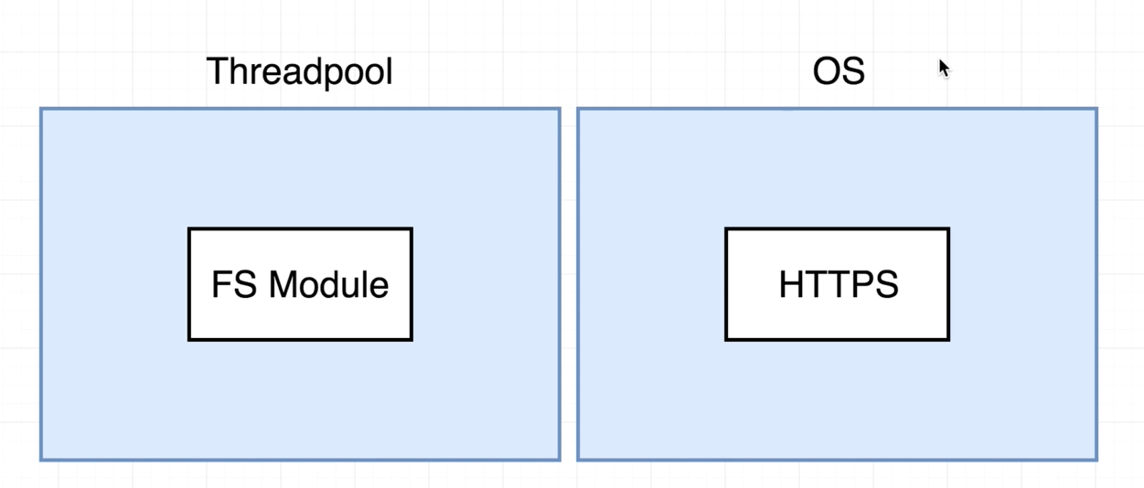
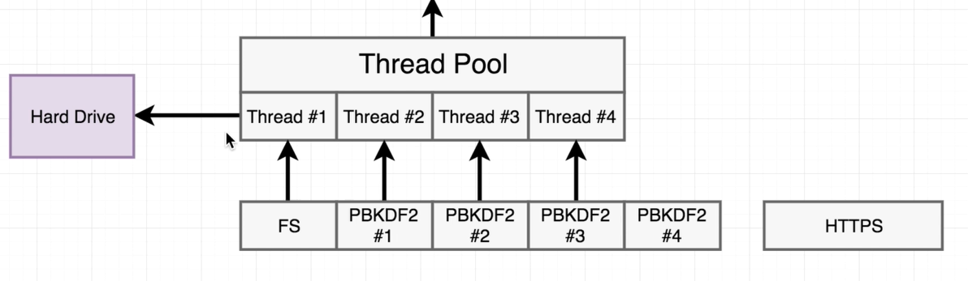
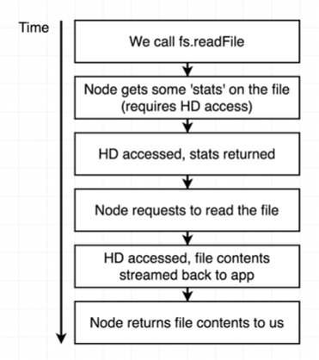
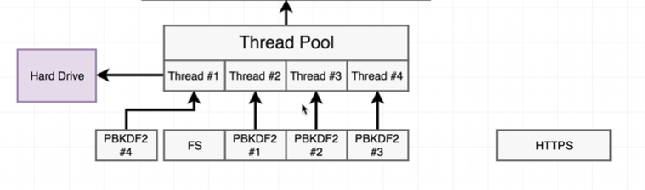
Multi-tasking

Slide 18
Multi tasking
Execute with the following settings and see the difference:
SET UV_THREADPOOL_SIZE = 2 && node app.js
OR
process.env.UV_THREADPOOL_SIZE=1

Slide 19
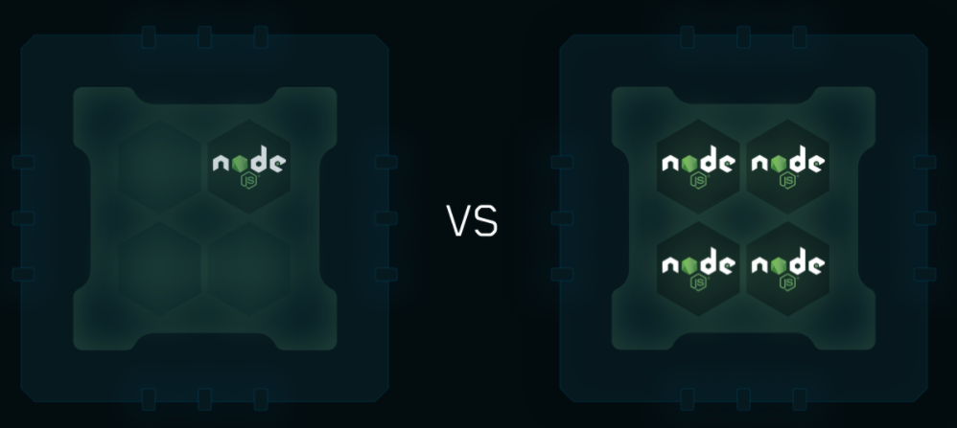
Node Performance
Cluster
To take advantage of multi-core systems, launch a cluster of Node.js processes to handle the load.
The cluster module allows easy creation of child processes that all share server ports.

Slide 20
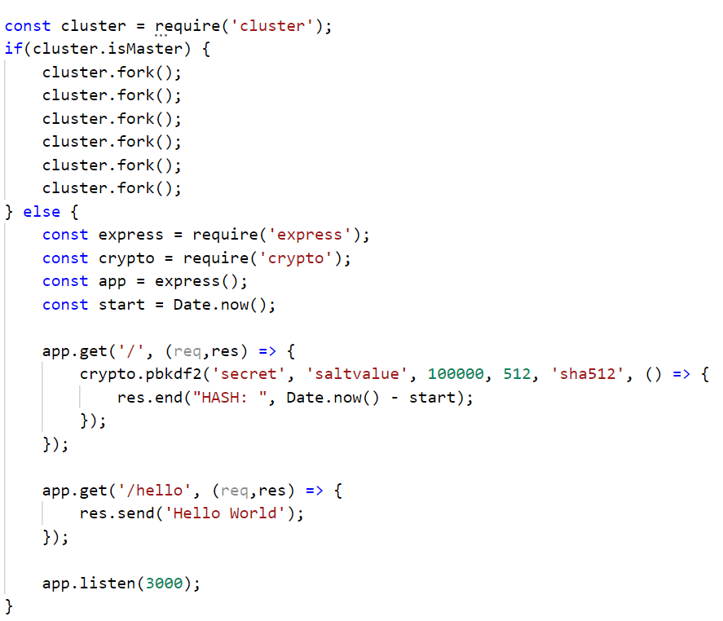
Cluster

Slide 21
PM2 in Cluster mode
PM2 is a daemon process manager that will help you manage and keep your application online.
npm i –g pm2
To enable the cluster mode, just pass the -i option:
pm2 start index.js -i 0/max
Monitoring CPU/Memory
pm2 monit
pm2 logs

Slide 22
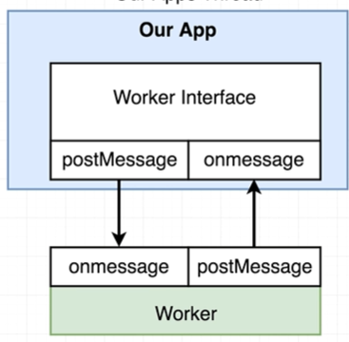
WebWorker Threads

Slide 23
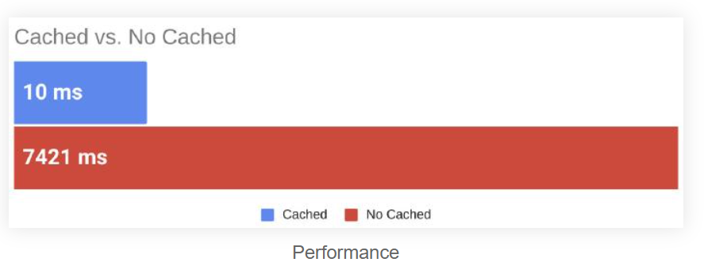
Redis for caching
Redis is an in-memory database, its data access operations are faster than any other disk-bound database could deliver.
Redis is a perfect choice for caching. Its key-value data storage is another plus because it makes data storage and retrieval much simpler.
Time Comparison: Using Postman to send requests to the server and measure request completion time.

Slide 24
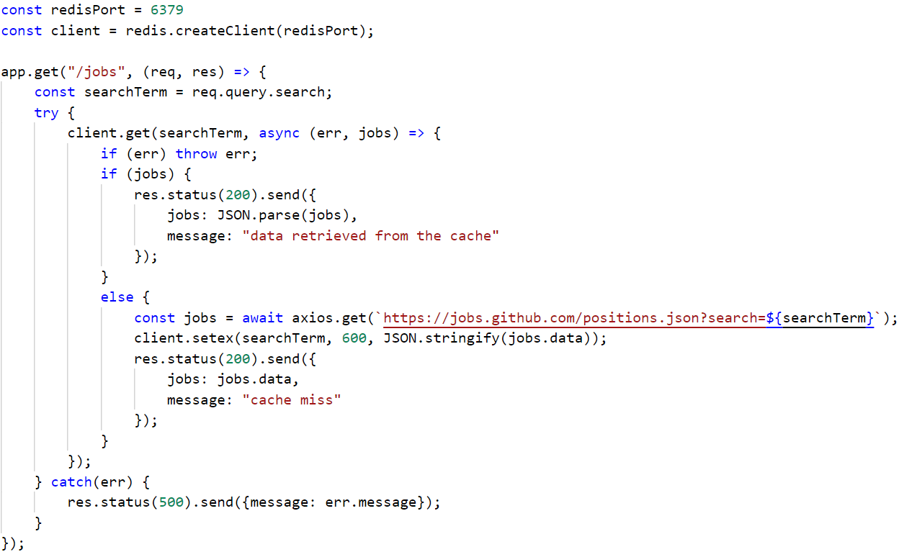

Redis for Caching

Slide 25
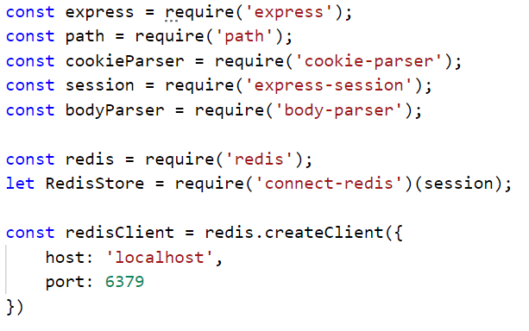
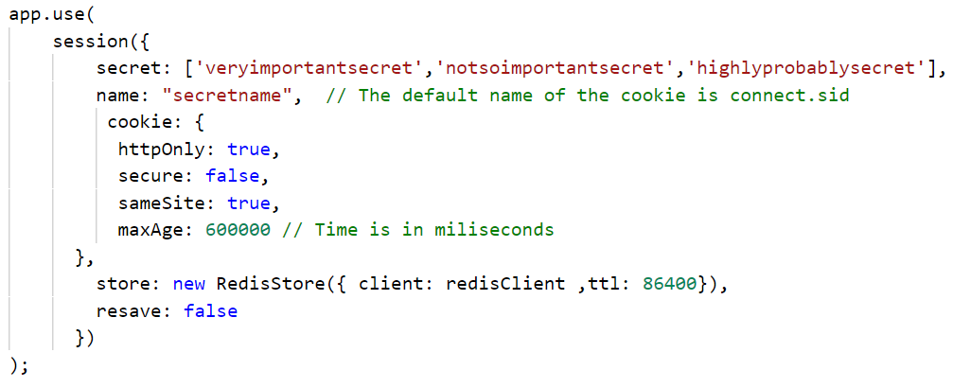
Redis for Session Store
The default server-side session storage, Memory Store, is purposely not designed for a production environment.
It will leak memory under most conditions, does not scale past a single process, and is meant for debugging and developing
This can be solved by using external Session Store. One popular session store is built using the Redis.

Slide 26

Node Tools
https://github.com/mcollina/autocannon
npm install –g autocannon
Autocannon –c 100 –d 5 -p 10 -l http://localhost:3000
-c/--connections NUM
The number of concurrent connections to use. default: 10.
-p/--pipelining NUM
The number of pipelined requests to use. default: 1.
-d/--duration SEC
The number of seconds to run the autocannon. default: 10.
-a/--amount NUM
The amount of requests to make before exiting the benchmark. If set, duration is ignored.
-m/--method METHOD
The http method to use. default: 'GET’.
-l/--latency
Print all the latency data. default: false.

Slide 27

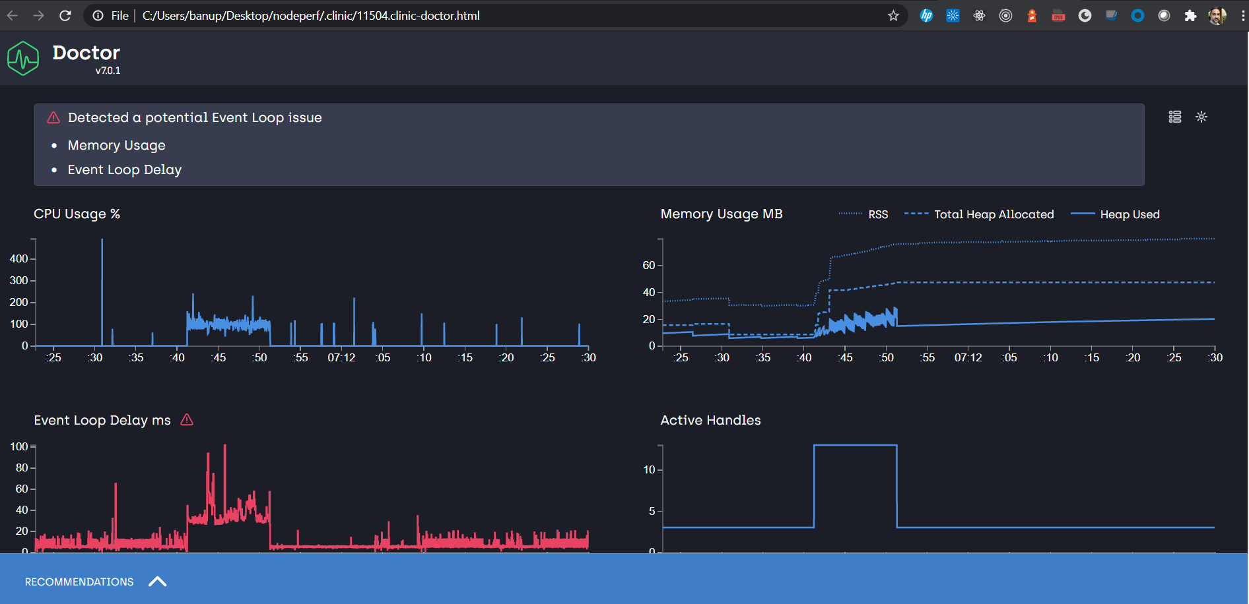
Node Tools
Diagnose performance issues in your Node.js applications
npm install -g clinic
clinic doctor -- node server.js
autocannon http://localhost:3000
or
clinic doctor --autocannon [ / --method POST ] -- node server.js

Slide 28
Event Sourcing
Event Sourcing is a powerful architectural pattern to handle complex application states that may need to be rebuilt, re-played, audited or debugged.
Good examples for Event Sourcing are version control systems that stores current state as diffs.
The current state is your latest source code, and events are your commits

Slide 29
Why is Event Sourcing useful?
In our hypothetical example, you are working on an online money transfer site, where every customer has an account balance.
Imagine you made a mistake and used a wrong currency exchange for the whole past week.
In this case, every account which sent and received money in a last seven days are in a corrupt state.
With event sourcing, there’s no need to panic!
You can revert the account balances to their previous uncorrupted state, fix the exchange rate and replay all the events until now.

Slide 30
Why is Event Sourcing useful?
With event sourcing you can:
Rebuild states completely
Replay states from a specific time
Reconstruct the state of a specific moment for temporary query

Slide 31
Example for Event Sourcing
Event Sourcing for our accounts:
// current account states (how it looks in our DB now)
const accounts = {
account1: { balance: 100 },
account2: { balance: 50 }
}
// past events (should be persisted somewhere, for example in a DB)
const events = [
{ type: 'open', id: 'account1', balance: 150, time: 0 },
{ type: 'open', id: 'account2', balance: 0, time: 1 },
{ type: 'transfer', fromId: 'account1', toId: 'account2': amount: 50, time: 2 }
]

Slide 32
Example for Event Sourcing
rebuild the latest state from scratch, using our event log:
// complete rebuild
const accounts = events.reduce((accounts, event) => {
if (event.type === 'open') {
accounts[event.id].balance = event.balance
} else if (event.type === 'transfer') {
accounts[event.fromId].balance -= event.amount
accounts[event.toId].balance += event.amount
}
return accounts
}, {})

Slide 33
Example for Event Sourcing
Undo the latest event:
const accounts = events.splice(-1).reduce((accounts, event) => {
if (event.type === 'open') {
delete accounts[event.id]
} else if (event.type === 'transfer') {
accounts[event.fromId].balance += event.amount
accounts[event.toId].balance -= event.amount
}
return accounts
}, {})

Slide 34
Example for Event Sourcing
Query accounts state at a specific time:
function getAccountsAtTime (time) {
return events.reduce((accounts, event) => {
if (time > event.time) return accounts;
if (event.type === 'open') {
accounts[event.id].balance = event.balance;
} else if (event.type === 'transfer') {
accounts[event.fromId].balance -= event.amount;
accounts[event.toId].balance += event.amount;
}
return accounts;
}, {})
}
const accounts = getAccountsAtTime(1)

